Slide 1
Blazor and Web Assembly
Jon Worthington
October 8, 2019

Slide 2
ASM.JS
Created by Mozilla in 2014
Subset of Javascript
Focus on performance
asm.js depends on type consistency and no garbage collection
Emscripten compiler allows to compile C program to asm.js version of Javascript
Browser creators incorporated further optimizations
Example software running on asm.js include Unreal Engine, Unity, SQLite, DosBox
C/C++/Rust/Go/etc.

Slide 3
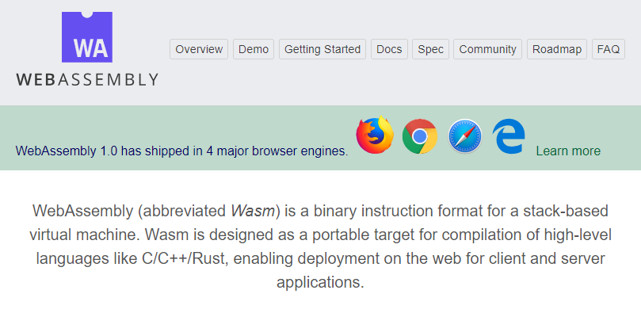
Then, in 2017 …

Slide 4
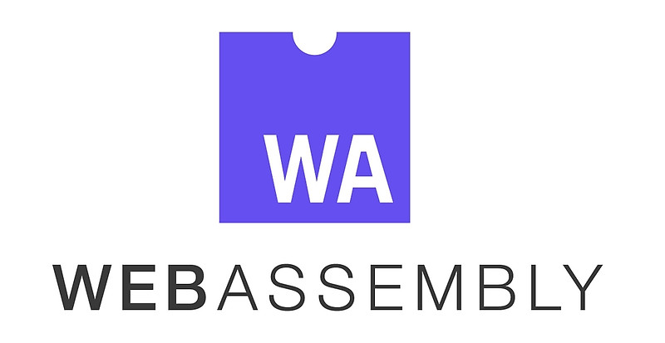
What is Web Assembly (WASM)
Web Assembly (WASM) is a low-level binary format language
That runs in modern web browsers
That runs at near-native speeds.
It’s a Compilation Target for other languages
Browser standard
No more JS monopoly

Slide 5
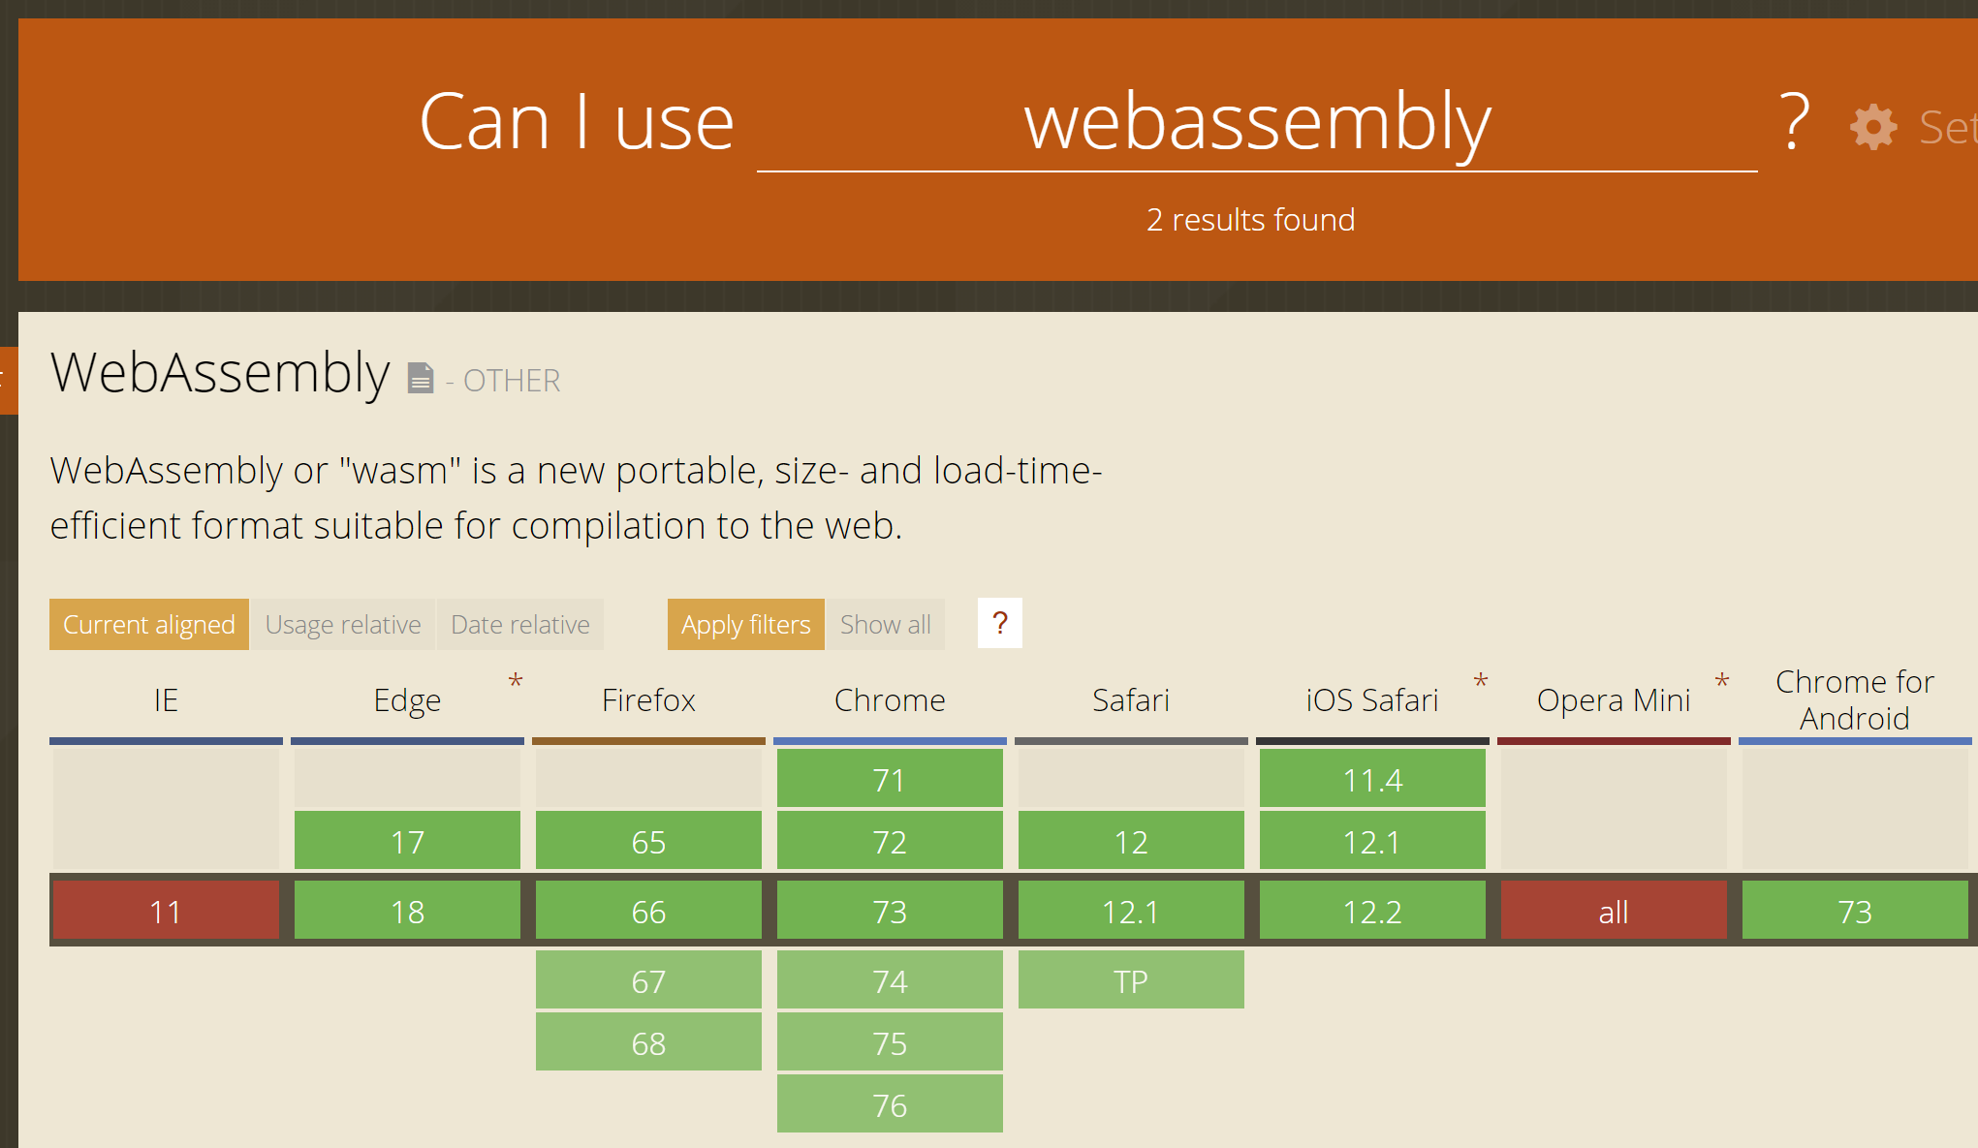
Is Web Assembly ready?

Slide 6
Web Assembly Goals
Fast, efficient, and portable
Wasm code can be executed at near-native speed in the browser
Readable and debuggable
Wasm code is a low-level assembly language but is in a human-readable text format
Secure
Designed to run in a safe, sandboxed execution environment like JavaScript in the browser

Slide 7
Web Assembly Crash Course
The web platform consists of two parts:
A virtual machine to run code
A set of APIs to control the browser
Traditionally, the browser’s VM has only been able to load JavaScript
WebAssembly adds an additional VM to run a compact binary format

Slide 8
Web Assembly Crash Course
Web Assembly is not meant to replace JavaScript
Intended to be a compilation target of source languages
Web Assembly can’t directly access the DOM
C/C++/C# source code
wasm module
HTML
Wasm compiler
JavaScript “glue” code

Slide 9
What is Blazor?
A .NET web framework that runs in the browser
Use C#/Razor to author
Runs on a .NET runtime implemented in WebAssembly
Browser + Razor = Blazor

Slide 10
.NET and Web Assembly
Mono as a compiler
Ooui - https://github.com/praeclarum/Ooui
Platform Uno - https://platform.uno/
Blazor - https://blazor.net/

Slide 11
Blazor was an “experimental” project
“... With this newest Blazor release we’re pleased to announce that Blazor is now in official preview. Blazor is no longer experimental and we are committing to ship it as a supported web UI framework including support for running client-side in the browser on WebAssembly…”
Full-stack web development with .NET via WebAssembly
No plugin or code transpilation
Works in all modern browsers including mobile browsers
Browser + Razor = Blazor!

Slide 12
Blazor Project Types
Client-side Blazor – Standalone: Creates a static client-side Blazor app which can be hosted by any web server (standard JS/HTML/CSS)
Client-side Blazor – ASP.NET Core backend: Creates a client-side Blazor app which is backed by ASP.NET Core
Server-side Blazor (Razor Components): Creates a server-side Blazor app which is backed by ASP.NET Core and renders the components on the backend providing UI updates via Signal-R

Slide 13
Blazor as part of .NET Core 3
Release date - September 2019
First version – only server-side, client-side will remain in preview until later => That said we will be working in client-side blazor today and you will see it is pretty robust and stable
Moving from server-side to client-side will be one line of code

Slide 14
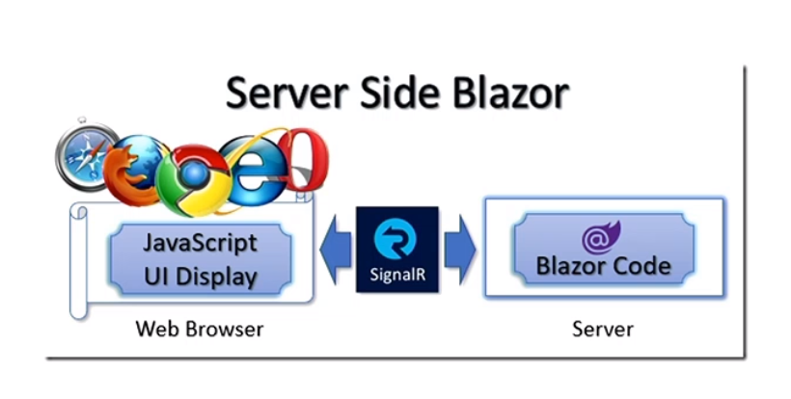
Server Side Blazor
Client app is executed on the server
All user interaction in browser are transported via Signal-R to server, which then executes client logic and transports back DOM updates

Slide 15
Pros and Cons of Server Side Blazor
Pros:
Browser doesn’t have to support WebAssembly to run this
App download size is significantly smaller
Useful for clients with limited resources
You can use server APIs on client side like IO
More secure – all source code stays on the server
Cons:
No offline support
Latency
Need better server hardware – server must manage multiple client connections and handle client state

Slide 16
Client Side Blazor
The principal hosting model for Blazor is running client-side in the browser on WebAssembly.
The Blazor app, its dependencies, and the .NET runtime are downloaded to the browser.

Slide 17
Pros and Cons of Client Side Blazor
Pros
There's no .NET server-side dependency. The app is fully functioning after downloaded to the client.
Client resources and capabilities are fully leveraged.
Work is offloaded from the server to the client.
An ASP.NET Core web server isn't required to host the app. Serverless deployment scenarios are possible (for example, serving the app from a CDN).
Cons
The app is restricted to the capabilities of the browser.
Capable client hardware and software is required.
Download size is larger, and apps take longer to load.
.NET runtime and tooling support is less mature.

Slide 18
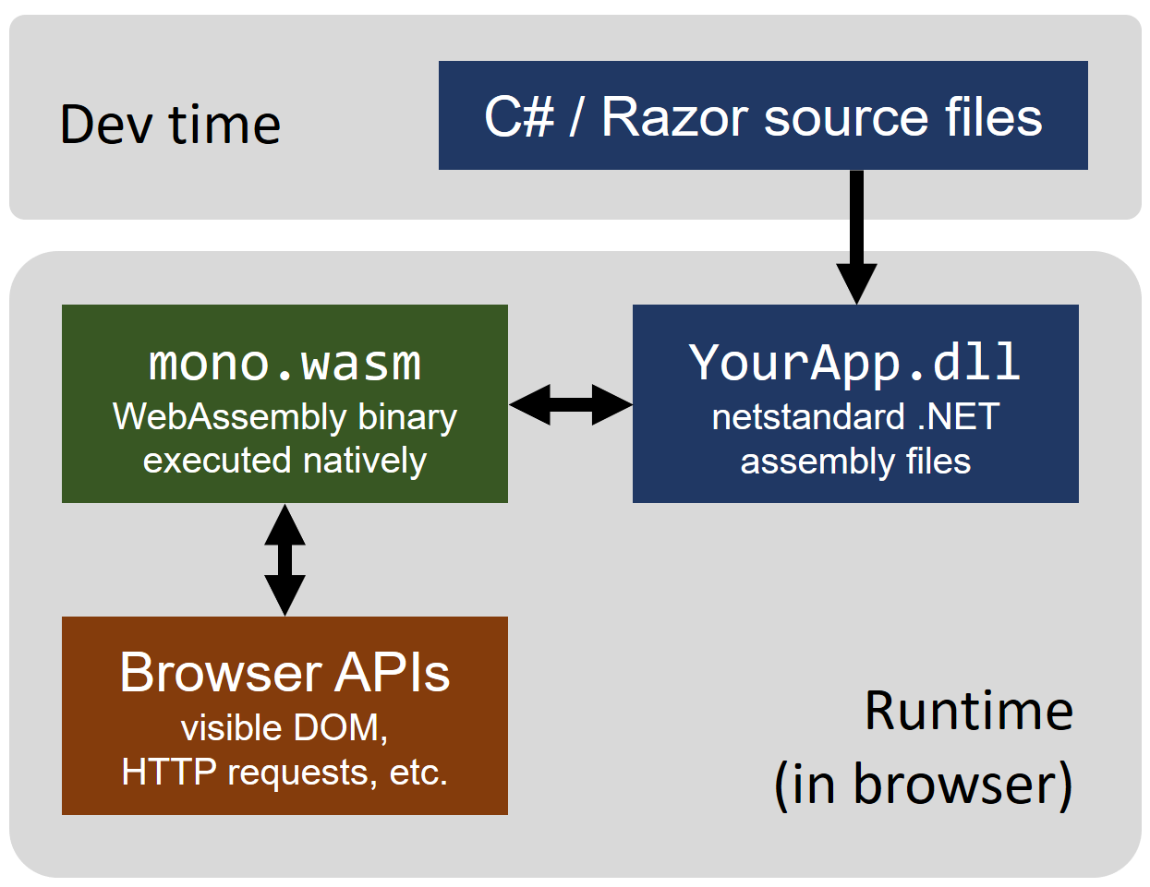
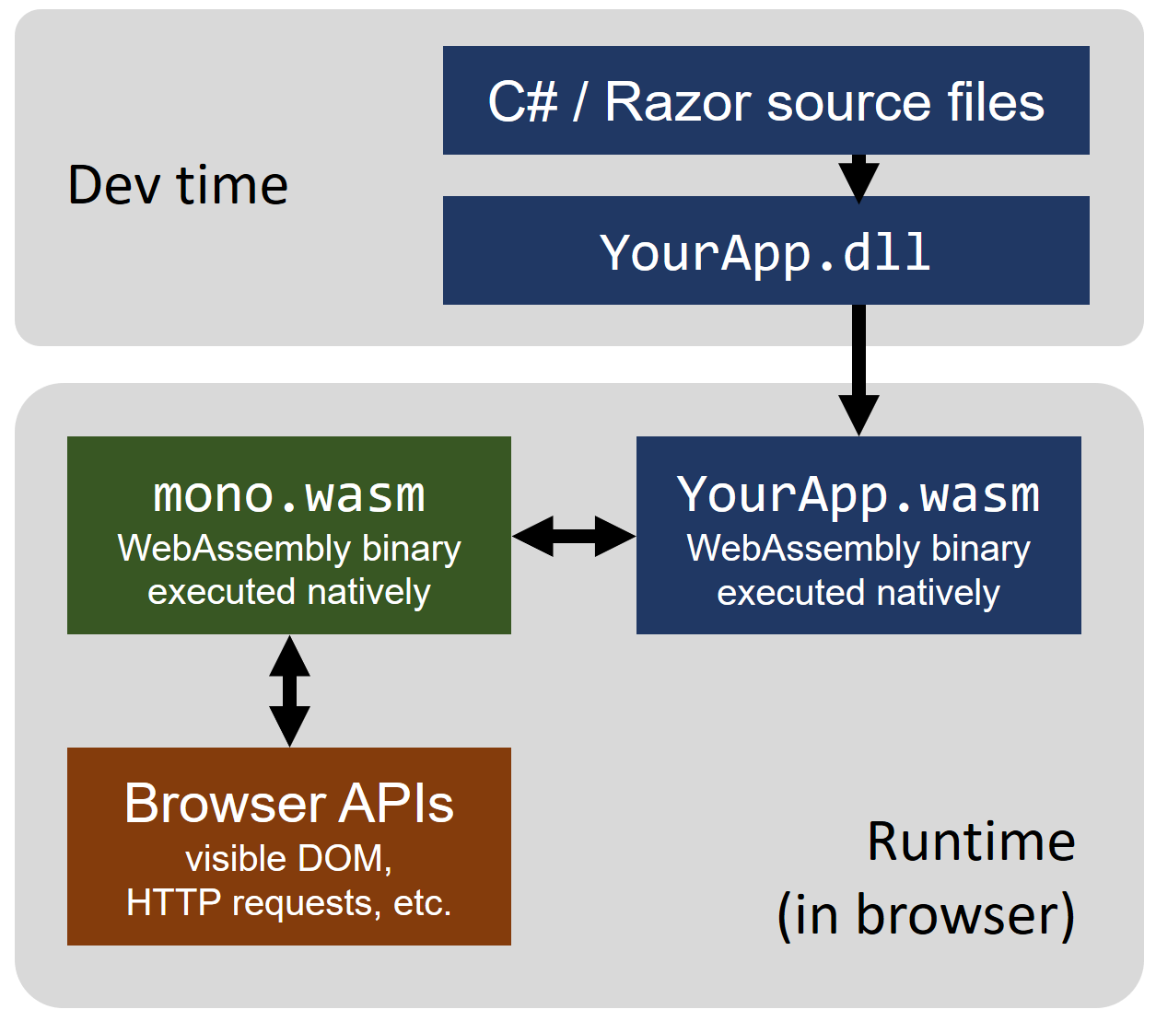
How Blazor Works
Today
Future

Slide 19
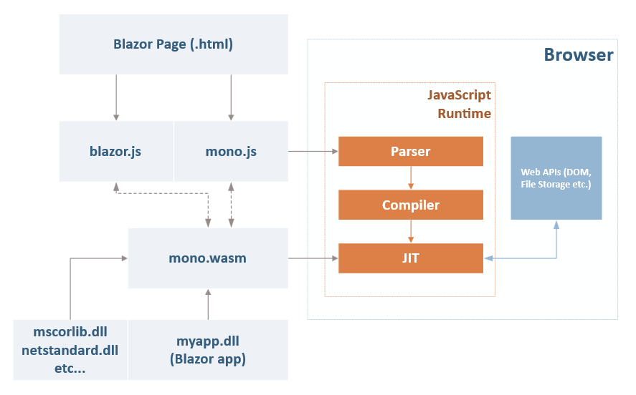
Inner Workings of Blazor

Slide 20
Problems with Blazor
Web Assembly is new
File size – larger than JavaScript (you download pretty much whole runtime) - Mitigated by tree shaking and caching
Performance –Mitigated by AOT compilation and improvements in WASM itself

Slide 21
What Blazor is not
Transpiled C# - you have whole .NET on frontend
Silverlight – you don’t need any plugin installed; it works on mobile!
Web Forms – it doesn’t try to work around web standards, it uses them

Slide 22
Getting Started with Blazor
https://docs.microsoft.com/en-us/aspnet/core/blazor/get-started?view=aspnetcore-3.0&tabs=visual-studio
Modern Browser (supports web assembly)
.Net Core 3.0 Preview SDK
Visual Studio Preview
Blazor code templates

Slide 23
Demo – Blazor Workshop
https://github.com/dotnet-presentations/blazor-workshop

Slide 24
Links
Blazor Workshop https://github.com/dotnet-presentations/blazor-workshop
Getting started with Blazor https://docs.microsoft.com/en-us/aspnet/core/blazor/get-started?view=aspnetcore-3.0&tabs=visual-studio
.NET Core 3.0 SDK https://dotnet.microsoft.com/download/dotnet-core/3.0
Visual Studio 2019 Preview https://visualstudio.microsoft.com/vs/preview/
Blazor Documentation https://docs.microsoft.com/en-us/aspnet/core/blazor/?view=aspnetcore-3.0

